Slide 1
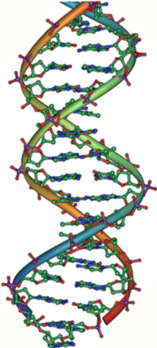
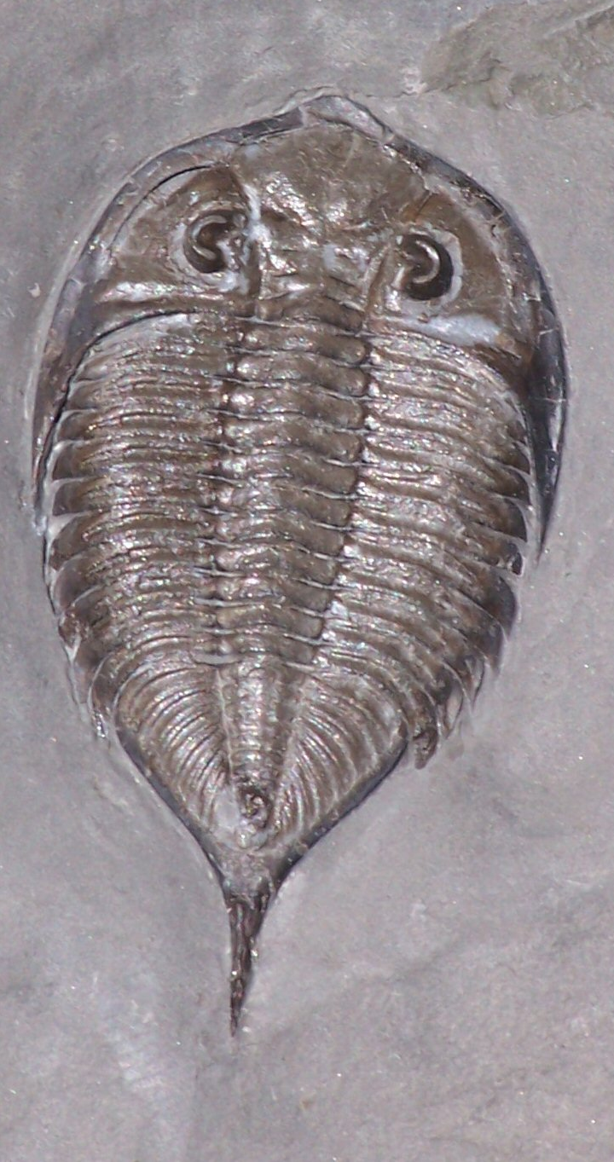
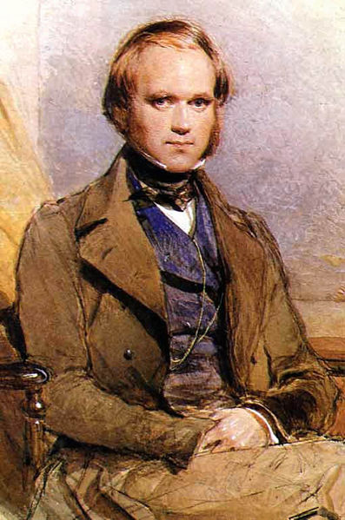
Evolution

Slide 2
Evolution is an important concept. The theory of evolution suggests that all living things arose from a single common ancestor in the distant past and that life continues to diversify today as new species appear.
Evolution explains why we can classify organisms into different groups because some organisms are more closely related than others.
Evolution explains why the cells of all organisms operate with the same kind of biochemical mechanism providing evidence of a common ancestor.
What is Evolution?

Slide 3
In the 1800s, scientists began to wonder if species could change their form or ‘transmute’. One of the early supporters of this idea was Jean Baptiste de Lamarck. Lamarck thought that if an animal acquired a characteristic during its lifetime, it could pass it onto its offspring. One of his favorite examples was the giraffe. In his view, the giraffe got its long neck through straining to reach the leaves on high branches, and this characteristic got passed down the generations.
Most scientists of his day thought that Lamarck was wrong. At that time, only a few radical thinkers like Charles Darwin’s grandfather, Erasmus, agreed that species could change over time.
Early thinking about Evolution

Slide 4
Early work with fossils
About the same time that discussions about transmutation (or evolution) of species was occurring, geologists like William Smith were beginning to map the rocks and fossils of Britain. Smith and others were able to show that rocks were laid down in a certain order and that the different fossils in different layers lived at different intervals of geological time. This was clear evidence that different species had existed in the past compared with today. However, Smith did not go on to ask the question, ‘Why?’ or to consider that this might be evidence for evolution.

Slide 5
Darwin
In the early nineteenth century, Charles Darwin rekindled ideas about evolution. From 1831-1836, Darwin toured the world on as a young naturalist.
He was astonished by the diversity of life. Through his travels he came across some remarkable fossils such as those of rodents the size of hippopotamuses and started to wonder how they might have originated.
Around 1842 Darwin read an essay about human population growth by Malthus, who had argued that human population would grow more quickly than food supply. The competition for food would become intense and only the fittest and most able would survive.

Slide 6
Darwin’s work continued
Darwin applied these ideas to all of life and came up with his now famous concept of Natural Selection. Darwin reasoned that if an organism possessed a characteristic that improved its chances of survival, then it would be more likely to pass on that characteristic to the next generation. Therefore organisms would become progressively adapted to their environment, leading to the evolution of new species. Darwin published this idea in his “Origin of Species by means of Natural Selection” in 1859.
Competition for food meant survival of the fittest organisms leading to natural selection of the best adapted organisms and eventually the evolution of a new species.

Slide 7
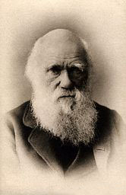
Charles Darwin (1809-1882) Sailed around the world 1831-1836

Slide 8
What did Darwin’s travels reveal?
The diversity of living species was far greater than anyone had previously known.
These observations led him to develop the theory of evolution.

Slide 9
Charles Darwin based his evolutionary theory in part on observations of finch species on the Galapagos Islands.
Different species of finch had developed different beak sizes for the types of food that was available on the different islands.
He suggested that the different species of finch had evolved from the original species in response to different environmental conditions.

Slide 10
How did tortoises and birds differ among the Islands of the Galapagos?
Each island had its own type of tortoises and birds that were clearly different from those living on the other islands.

Slide 11
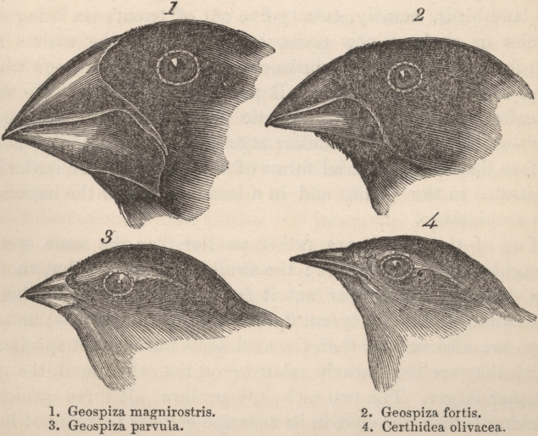
http://wps.pearsoncustom.com/wps/media/objects/3014/3087289/Web_Tutorials/17_A02.swf
http://wps.pearsoncustom.com/wps/media/objects/3014/3087289/Web_Tutorials/17_A02.swf

Slide 12
Galapagos Turtles
Short Neck
Long Neck

Slide 13
Lamark & the Theory of Acquired Characteristics
Lamark said organisms acquired traits by using their bodies in new ways.
These new characteristics were passed to offspring.
Lamark was totally wrong!

Slide 14
Evolution is a Theory – Just like Gravity! Right?
Evolution is a well supported explanation of phenomena that have occurred in the natural world.
A theory in science is a well-tested hypothesis, not just a guess.

Slide 15
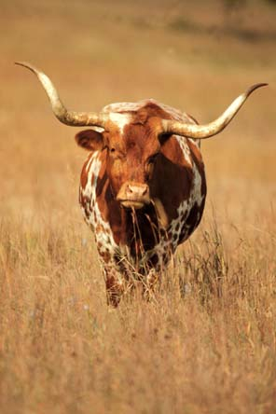
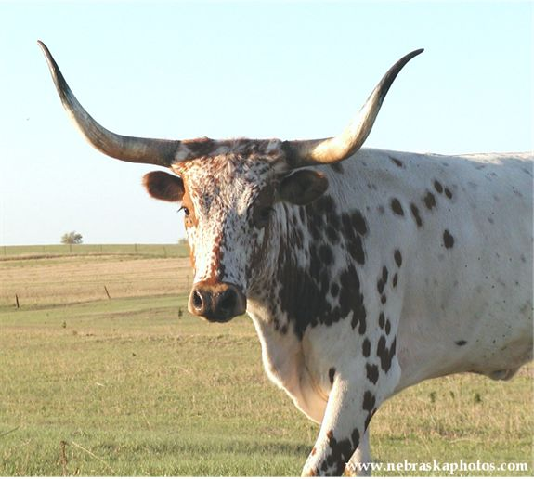
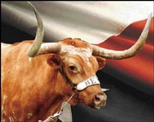
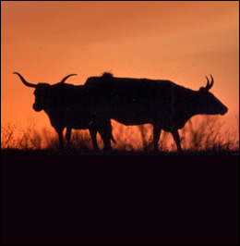
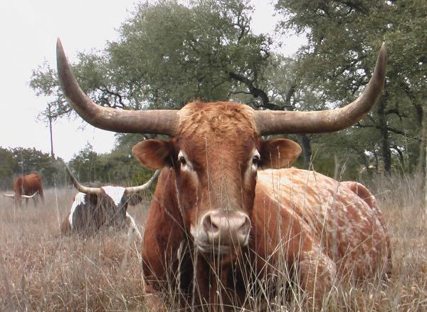
Artificial Selection
Nature provides variation. Humans select variations that are useful.
For example, a farmer breeds only his best livestock.

Slide 16
Natural Selection and Species Fitness
Overtime, natural selection results in changes in the inherited characteristics of a population.
These changes increase a species fitness (survival rate).

Slide 17
Natural Selection
The traits that help an organism survive in a particular environment are “selected” in natural selection.

Slide 27
Summary of Darwin’s Theory
1. Organisms differ; variation is inherited.
2. Organisms produce more offspring than will survive.
3. Organisms compete for resources.
4. Organisms with advantages survive and pass those advantages on to their children.
5. Species alive today are descended with modifications from common ancestors.

Slide 28
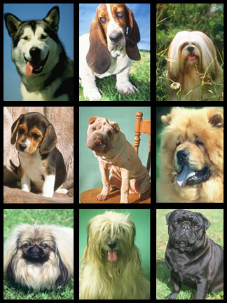
Theory of Natural Selection
Darwin knew from personal experience that dog breeders can produce new species over time by selective breeding techniques. Breeding dogs with desired traits produces a new breed of dog. This process is called artificial selection.
He thought this process might
be naturally occurring in nature
and termed it natural selection.

Slide 29
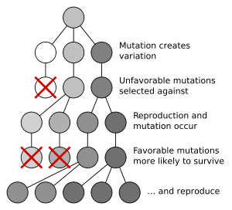
Key Principles of Natural Selection
Overproduction - most organisms produce more offspring than can survive.
Variation - visual differences among individuals result from differences in genetic material. This process of changing base pairs in the DNA is called a mutation.

Slide 30
Adaptation - a trait that improves an organism’s chance for survival and reproduction.
Selection - the individuals that have the adaptation increase in numbers and are able to adapt to the environment as compared to the individuals who do not have the adaptation.

Slide 31
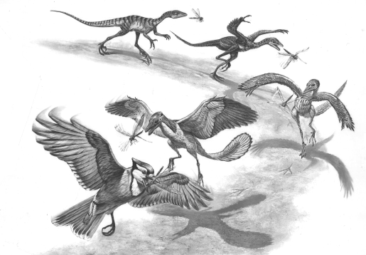
Descent with Modification
Each living species has descended with changes from other species over time

Slide 32
Evidence of Evolution
Fossil Record
Geographic Distribution of Living Species
Homologous Body Structures
Similarities in Embryology

Slide 33
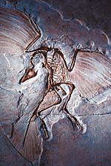
Evidence of Evolution
Fossil record provides evidence that living things have evolved.
Fossils show the history of life on earth and how different groups of organisms have changed over time.

Slide 34
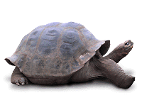
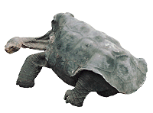
Evidence of Evolution
Geographic Distribution of Living Species
Similar animals in different locations were the product of different lines of descent.

Slide 35
Evidence of Evolution
Homologous Body Structures
Structures that have different mature forms but develop from the same embryonic tissues
e.g. wing of bat, human arm, whale flipper, leg of cat

Slide 36
Homologous Body Structures

Slide 37
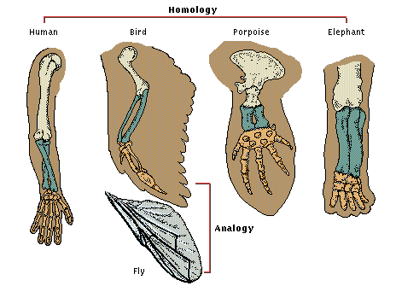
Analogous Structures look different but essentially perform the same function for each organism.

Slide 38
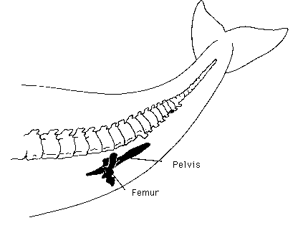
Vestigial Organs - physical structures that were fully developed and functional in an earlier group of organisms but are reduced and unused in later species.

Slide 39
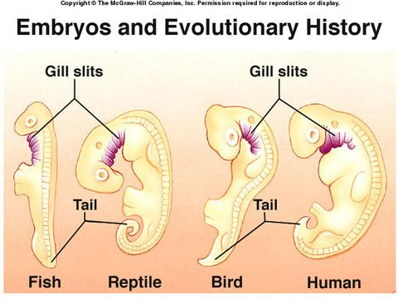
Evidence of Evolution
Similarities in Embryology
In their early stages of development, chickens, turtles and rats look similar, providing evidence that they shared a common ancestry.

Slide 40
Embryological Development

Slide 41
Vestigial Organs
just one more piece of evidence to support the Theory of Evolution
traces of homologous organs have been found in other species
The appearance of organs that serve no useful function, like the appendix

Slide 42
Genetics
Also during this time, an Austrian monk called Gregor Mendel was carrying out important experiments that would eventually prove that Darwin’s Natural Selection was in fact correct.
For 7 years, Mendel cross-bred different strains of pea plants to investigate how characteristics like the color of the flowers got passed down the generations.
He cultivated almost thirty thousand pea plants and figured out the basic principles of what would later become known as Genetics. He showed that offspring received characteristics from both parents, but only the dominant characteristic was expressed in the offspring
This was contrary to the prevailing view at the time that the characteristics of both parents were somehow “blended” together. Unfortunately, Mendel’s work was overlooked by scientists until long after his death.

Slide 43
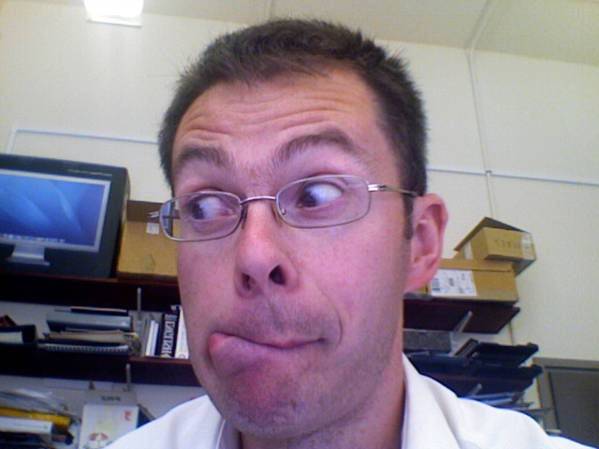
How evolution works
The genetic make-up of an organism is known as its genotype. The genotype of an organism and the environment in which it lives (nature and nurture together) determine the characteristic traits of the organism, or its phenotype.
Genotype
Phenotype

Slide 44
Genetics and DNA
The genotype of an organism is stored in DNA molecules, within the nucleus of every cell.
Every time an organism grows a new cell a new copy of the DNA is created. It is important that every copy of the DNA is identical, since any errors copying the genotype may prevent the cell from functioning properly.
In 1953, Watson and Crick figured out that DNA had a helical structure and showed how it copies itself with accuracy. When DNA replicates, the helix unwinds and each strand produces an exact mirror image copy of itself. This ensures that each copy is identical to the original.

Slide 45
Mutations give rise to variants, or alleles, of the same gene. One person may have one set of alleles, and another person, a different set. For example, hair colour in humans. One of the genes that codes for hair color occurs as two alleles, brown and blonde. In the case of hair color, brown is dominant and blonde is recessive. If a person gets a brown allele from one parent and a blonde allele from the other parent, they will have brown hair. A person will only have blonde hair when they receive blonde alleles from both parents.
Mutations
Mendel showed that one allele is usually dominant and the other recessive.

Slide 46
Mutations
Mutant alleles spread through a population by sexual reproduction. If an allele exerts a harmful effect, it will reduce the ability of the individual to reproduce and the allele will probably be removed from the population. In contrast, mutations with favorable effects are preferentially passed on.
Only those mutant alleles that have beneficial effects that increase the likelihood of reproduction will be passed on to offspring. In this way, harmful alleles are removed from a population while favorable alleles accumulate.
This is Darwin’s concept of Natural Selection and shows how a population adapts to its environment over time.

Slide 47
The case of the Peppered Moth shows how natural selection can change the frequency (or proportion) of alleles in a population. An example of the same phenomenon is the breeding of dogs. Humans have been breeding dogs for thousands of years and trying to develop certain characteristics.
This “artificial selection” is exactly the same process as natural selection but controlled by human intention rather than natural forces.
Although humans have been successful in changing the frequency of alleles in different dog breeds, they haven’t created new species. The definition of a species is a population that can interbreed and produce fertile offspring. Most dogs can successively interbreed with other dogs, and also with wolves, so in actual fact all dog breeds are just subspecies of the wolf.
The dog is another example of how selection can change the frequency of alleles in a population.
Dogs have been artificially selected for certain characteristics for many years, and different breeds have different alleles.
All breeds of dog belong to the same species, Canis lupus (the wolf) so no new species has resulted.

Slide 48
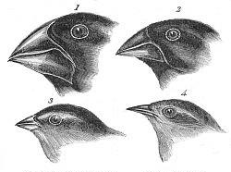
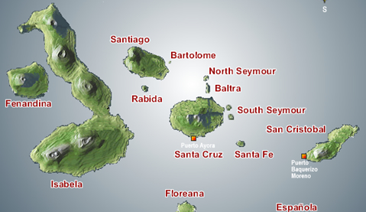
Micro and Macro Evolution
Galapagos finches
To give rise to a new species, Microevolution needs to go on for more much longer than humans have been breeding dogs.
If a species was to become divided into two isolated populations for tens of thousands of years, then natural selection would eventually change the frequency of alleles to such an extent that members of the two populations could no longer interbreed. This process would result in the birth of new species or speciation.
Where speciation occurs, biologists refer to the process as Macroevolution. An example of Macroevolution is that observed by Charles Darwin when visiting the Galapagos Islands in the Pacific Ocean. He noticed that each island had its own distinctive species of finch. Darwin argued that the islands had originally been colonized by just one species of finch, but then in isolation, each island population had evolved in response to different environmental conditions.

Slide 49
Evidence of Evolution
HUMAN CCAAGGTCACGACTACTCCAATTGTCACAACTGTTCCAACCGTCACGACTGTTGAACGA
CHIMPANZEE CCAAGGTCACGACTACTCCAATTGTCACAACTGTTCCAACCGTCATGACTGTTGAACGA
GORILLA CCAAGGTCACAACTACTCCAATTGTCACAACTGTTCCAACCGTCACGACTGTTGAACGA
Genetic code of chimps and gorillas is almost identical to humans
One of the most striking pieces of evidence for evolution is the basic similarity of all living things.
All living things pass on genetic information from generation to generation using the DNA molecule. If life was generated through evolution then we might also predict that closely related organisms will be more similar to one another than more distantly related organisms. Studies show that chimpanzees, our closest relations, are nearly genetically identical (their genes differ by only 1.2%) whereas the more distantly related mouse differs by 15%.

Slide 50
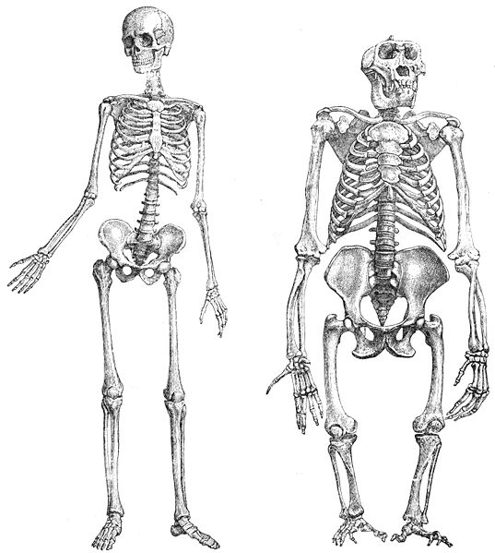
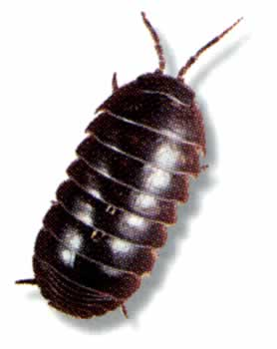
Evidence of Evolution: Comparative Anatomy
Similar comparisons can be made
based on anatomical evidence.
The skeleton of humans and
gorillas are very similar suggesting
they shared a recent common
ancestor, but very different from the
more distantly related
woodlouse…yet all have a common
shared characteristic:
bilateral symmetry
Human and Gorilla
Woodlouse
en.wikipedia.org/wiki/Image:Primatenskelett-drawing.jpg

Slide 51
Evidence of Evolution
In the last slide, you saw that very similar comparisons can be made based on anatomical evidence.
The skeleton of humans is very similar to that of the gorilla, our close relative, but both are very different from the exoskeleton of the woodlouse. Yet even primates and woodlice share some basic anatomical characteristics such as bilateral symmetry suggesting that they are all related. This is clear evidence for the inter-relatedness of all living things.

Slide 52
Evidence of Evolution
Another piece of evidence that supports evolution is the concept that biologists have called homology. Homology refers to an anatomical feature possessed by an ancestor that has been modified by its descendents for a specific function.
For example, the pentadactyl (or five fingered) limb is found in all vertebrates from fish to amphibians to reptiles to mammals to birds. This structure is easily recognizable in all these diverse groups of organisms but has been adapted to suit particular purposes in each. So we find it adapted as wings for flight in birds, as fins for swimming in fish, as scrapers for digging amongst moles and so on. As all these diverse organisms have the same anatomical blueprint, this strongly suggests they are inter-related.

Slide 53
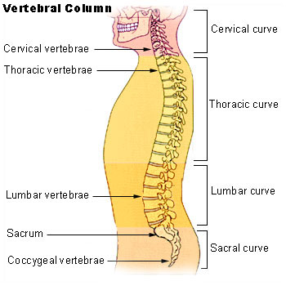
Evidence of Evolution: Vestigial Structures
As evolution progresses, some
structures are no longer of use. These
are known as vestigial structures.
The coccyx is a much reduced
version of an ancestral tail, which
was formerly adapted to aid
balance and climbing.
Another vestigial structure in
humans is the appendix.
The coccyx is a vestigial tail
en.wikipedia.org/wiki/Image:Illu_vertebral_column.jpg
Notes:
Features that get sidelined by evolution in this way are called Vestigial Structures. One example is the human coccyx or tail bone which is a much reduced version of a bony tail possessed by our ancestors. Formerly adapted to aid balance and climbing, a tail has little function in human behaviour so has been selected against. It probably has been retained in a vestigial form because it has some use as a point for muscle attachment in the bottom. Another example of a vestigial human organ is the appendix.

Slide 54
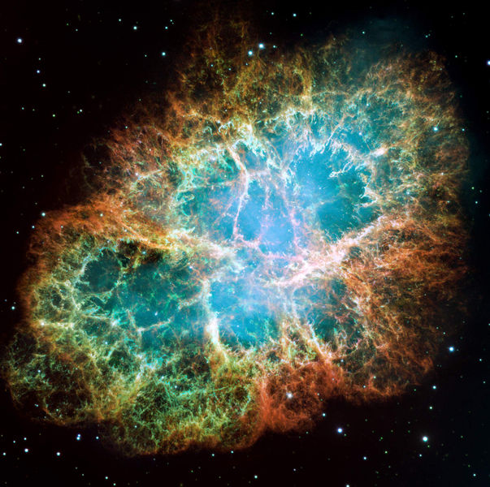
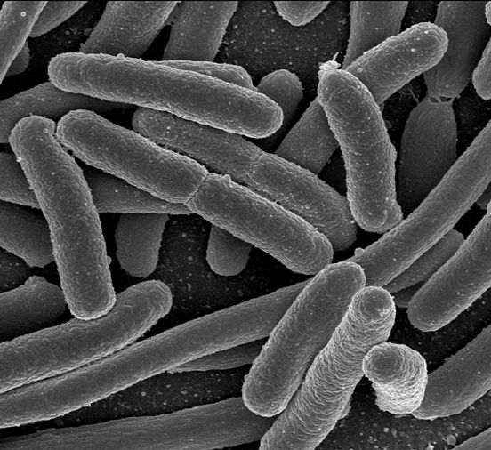
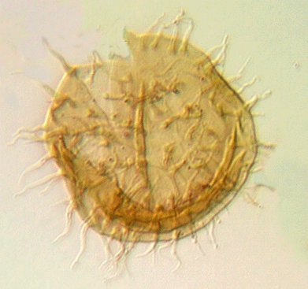
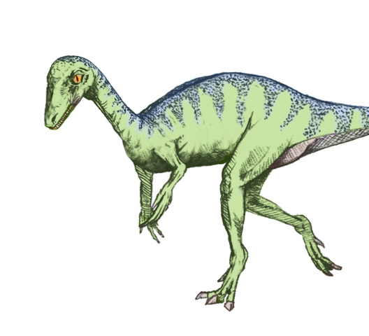
Fossil Record
origins
bacteria
complex cells
dinosaurs
humans
The fossil record shows a sequence from simple bacteria to more complicated organisms through time and provides the most compelling evidence for evolution.
Notes:
All the pieces of evidence that we have discussed so far point to the inter-relatedness of all living things and their evolution from a single common ancestor. However, perhaps the most compelling piece of evidence in support of evolution is the fossil record itself. The fossil record shows a sequence from simple bacteria in the oldest rocks through to more complicated organisms like dinosaurs and humans in much younger rocks. It shows that different species arose at different times and, as we see in the next slide, in many cases there are clear transitions from one species, or group, to another.
Background note: A companion talk on the History of Life can be downloaded from the Your Planet Earth website: http://www.earth4567.com/talks/life.html

Slide 55
Fossil Record
The fossil record shows a sequence from simple bacteria in the oldest rocks to more complicated organisms like dinosaurs and humans in much younger rocks. It shows that different species arose at different times and, as we see in the next slide, in many cases there are clear transitions from one species, or group, to another.

Slide 56
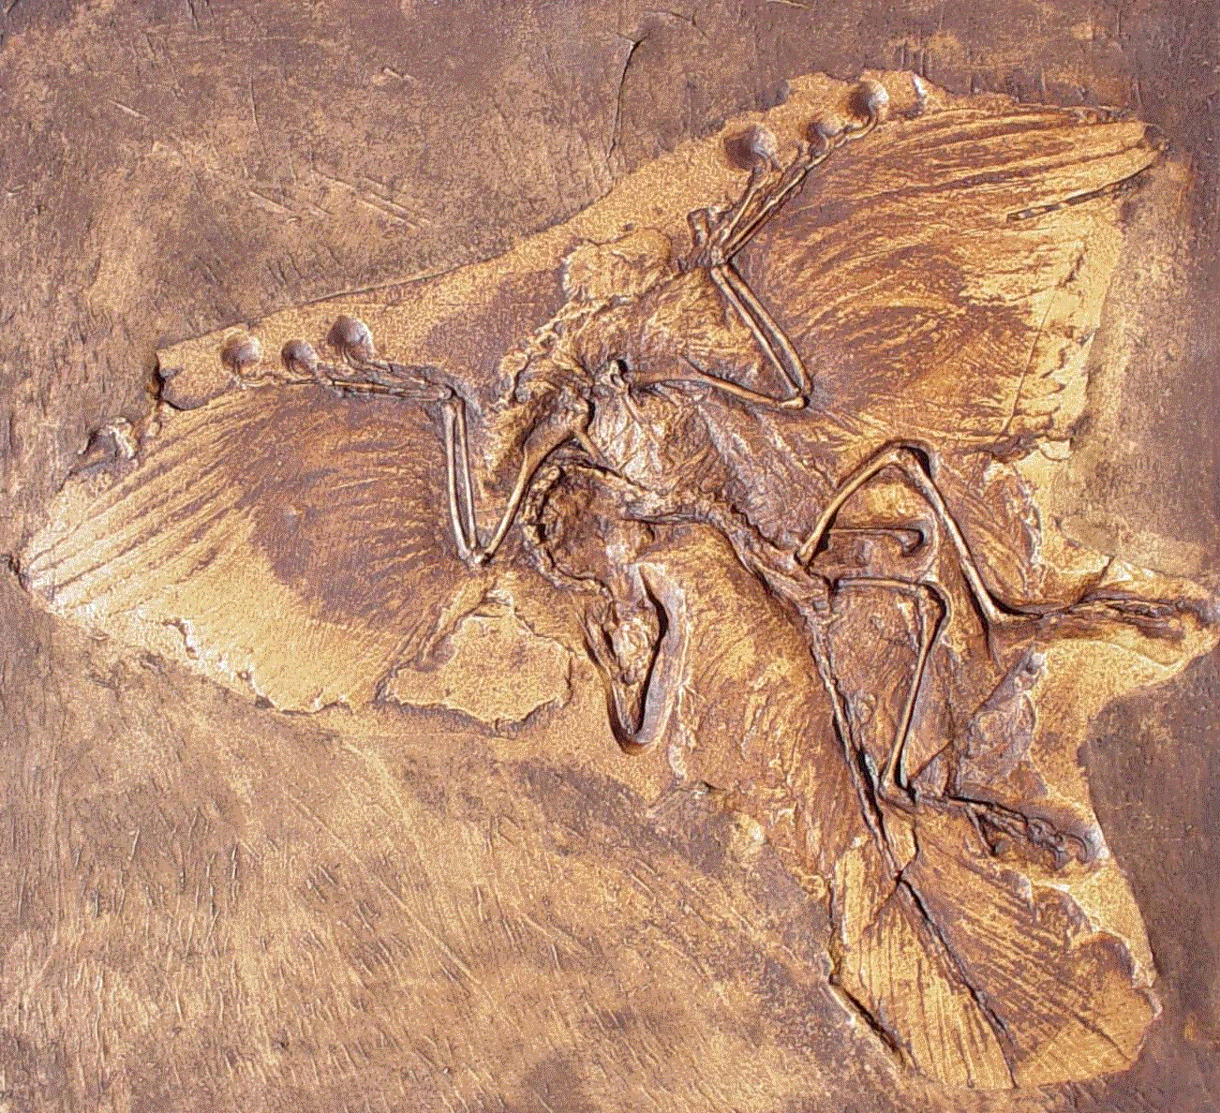
Transitional fossils
Transitional fossils show a clear transition from one species, or group, to another.
Archaeopteryx was found
in Germany in 1861. It
share many characteristics
with both dinosaurs and
birds.
It provides good evidence
that birds arose from
dinosaur ancestors
Archaeopteryx
Notes:
One of the most famous examples of a species that is transitional between two major groups, is the 150 million year old Archaeopteryx. Archaeopteryx has several characteristic features seen in certain dinosaurs including teeth and a bony tail. However, it has more features that are characteristic of modern birds such as a wishbone, wings with flight feathers, and a partially reversed first toe. Although geologists classify Archaeopteryx as an early fossil bird they recognize that it is more closely related to the dinosaurs than any birds living today. Archaeopteryx therefore provides good evidence of the evolutionary transition from dinosaurs to birds.

Slide 57
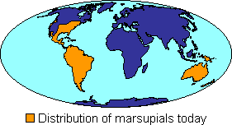
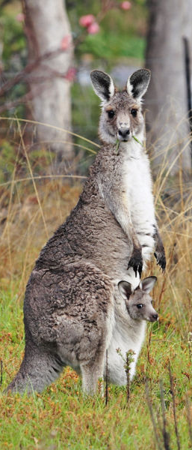
Geography
Geographic spread or distribution of organisms also tells of their past evolution.
Marsupials occur in
two populations today
in the Americas and
Australia.
This shows the group
evolved before the
continents drifted apart
Marsupials
Notes:
A rather different source of evidence in support of evolution comes from the geographic distribution of species today. If we take for example the case of marsupials, we see that this primitive group of mammals is found in the Americas and Australasia. Marsupials are not renowned as strong swimmers so this raises the questions as to how two populations came to be separated by the Pacific Ocean if they evolved from a common ancestor. However, this problem is resolved if we remember that the Earth’s continents have not remained stationary over time but have drifted around the surface of the Earth. During the Jurassic Period, 160 million years ago, all the Southern Hemisphere landmasses were joined together and you could have walked from Australia to South America across what is present day Antarctica. Fossil evidence shows that marsupials evolved in the Jurassic but after the continents started to break-up, the marsupials must have got separated into two populations, one in the Americas and the other in Australasia. In fact fossil marsupials have even been found in Antarctica and South Africa as well, providing evidence that that these continents acted as a land bridge connecting the two populations for a time.

Slide 58
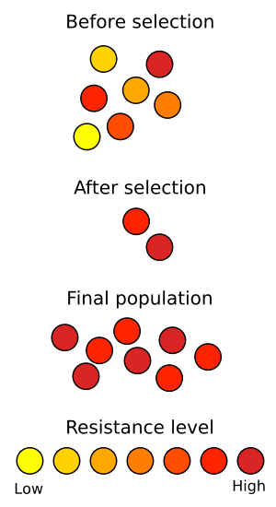
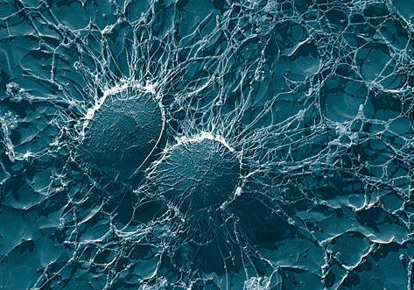
Antibiotic resistance
Staphylococcus
We are all familiar with the way that certain bacteria can become
resistant to antibiotics
Antibiotic resistance is an example of natural selection in action. The antibiotic acts as an environmental pressure. It weeds out those bacteria with low resistance and
only those with high resistance survive to reproduce.
Notes:
Another convincing piece of evidence for evolution is the familiar way that bacteria may become resistant to antibiotics. Bacteria have a fast life cycle and can produce a new generation every 4 hours. As natural selection acts on each generation this means bacteria can rapidly respond to environmental pressures. In effect the antibiotics act to weed out those bacteria with low resistance in each generation. Only bacteria with high resistance survive and pass their alleles to the next generation. Consequently, in just a short time, natural selection increases the resistance level of the bacteria population. This is an example of evolution in action amongst the simplest organisms on our planet – and then having an impact on the most complex organisms!

