Slide 1
Infectious Diseases
Notes:
1

Slide 2
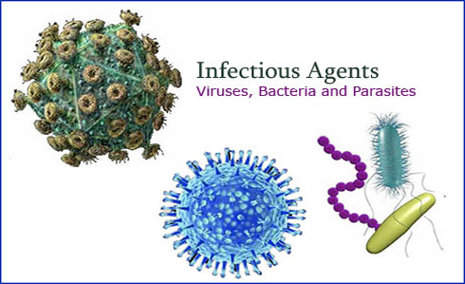
What is an Infectious Disease?
Infectious Disease - A disease that is caused by pathogens entering your body.
Pathogen - Any organism that causes a disease.
Notes:
2

Slide 3
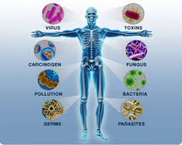
Pathogens
Major Human Pathogens:
Parasites
Bacteria
Viruses
Fungi
Protozoans
Notes:
3

Slide 4
How are Pathogens Spread?
The 4 Ways Pathogens Spread:
Infected People
Infected Animals
Contaminated Object
Soil, Food, and Water
Notes:
4

Slide 5
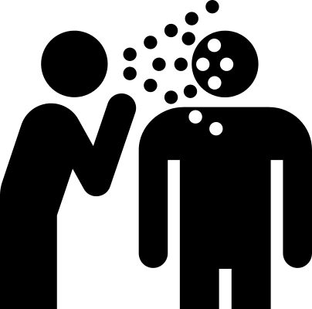
Infected People
Pathogens pass from one person to another person…
Directly - Kissing, Shaking Hands, etc.
and
Indirectly - Sneezing,
Coughing, etc.
Notes:
5

Slide 6
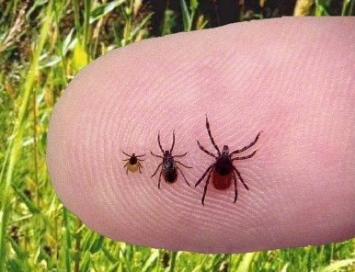
Infected Animals
Infected animals can bite a person and pass the pathogen to them.
Example: Ticks can transmit Bacteria to humans when they bite, giving the humans Lyme Disease.
Notes:
6

Slide 7
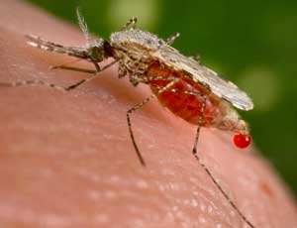
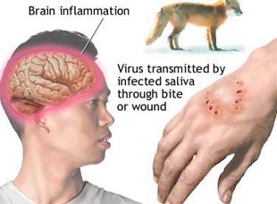
Vectors
Vectors - The hosts or carriers that spread pathogens and disease.
Examples: Mosquitos, Ticks, Dogs

Slide 8
Vector-borne Diseases
Vector-borne Disease – Any diseases that is spread to humans through direct contact with an infected animal.
Examples: Rabies from a dog bite, Lyme disease from a Tick, Malaria from a Mosquito

Slide 9
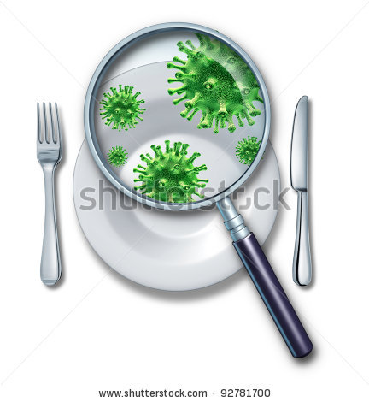
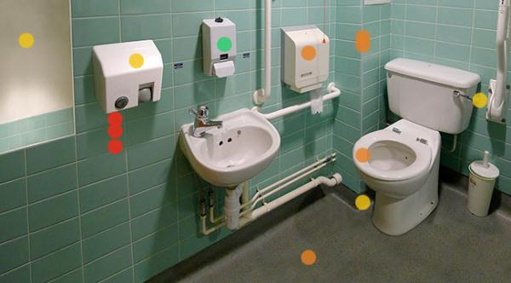
Contaminated Object
Pathogens that can survive outside the body are transferred from infected person, to an object, and then to another person.
Notes:
9

Slide 10
Soil, Food, and Water
Some pathogens occur naturally in the environment and can be transferred to people through soil, food and water.
Examples: Cholera and Dysentary are two deadly diseases that spread through food and water.
Notes:
10

