Slide 1
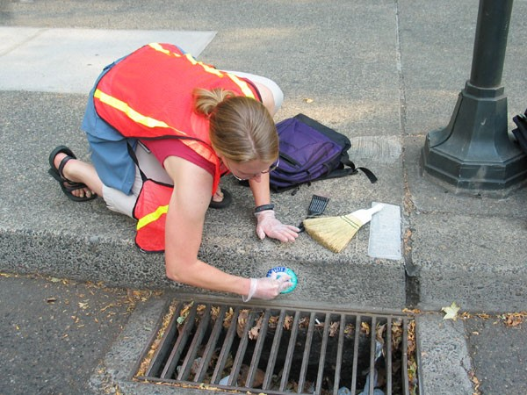
Water Quality Indicators

Slide 2
Units for Measuring Water Quality

Slide 3
PARTS PER MILLION
Most dissolved substances found in water are measured in parts per million (ppm) or even smaller amounts. This means that for every one million parts (units) of water there is a certain number of parts of the substance.

Slide 4
It is also expressed as milligrams per liter. There are 1000 milliliters in a liter and 1000 milligrams in a gram. For example, a dissolved oxygen reading of 8 ppm means there are 8 milligrams of oxygen for every 1000 milliliters of water.
8/1000 gram ÷ 1000 milliliters =
8/1,000,000 (8 parts per million)

Slide 5
Concentrations of certain substances are also measured in parts per billion, parts per trillion and so on. These are very small amounts but certain substances can be harmful even at these very low concentrations.

Slide 6
Water Quality Indicators
We will now take a look at the water quality indicators.

Slide 7
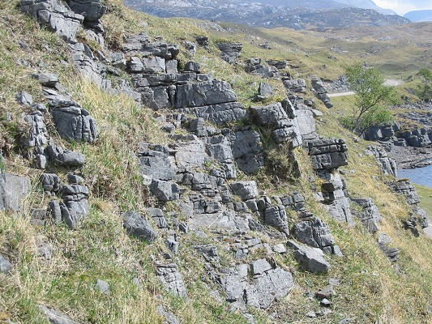
ALKALINITY
Alkalinity refers to the water’s ability to neutralize acids.
Alkalinity is produced by minerals such as limestone.
Limestone is a type of ocean sediment composed of calcium carbonate.

Slide 8
Limestone bedrock areas often have caves and sinkholes, known as Karst.
Water with low alkalinity is usually acidic.

Slide 9
Ammonia
Ammonia is produced by the decay of organic matter and animal waste.
Ammonia is toxic to most aquatic life, especially at high pH.
Bacteria readily convert ammonia to nitrate.
(a plant nutrient)

Slide 10
Ammonia
Ammonia is a form of nitrogen and part of the Nitrogen Cycle.

Slide 11
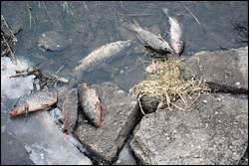
BACTERIA
Most bacteria are important in nutrient and other organic cycles.
Excess nutrients cause algal blooms. As algae die and decay, the high bacterial load rapidly consumes dissolved oxygen.

Slide 12
Certain types of bacteria indicate animal and human waste pollution.
Escherichia coli are coliform bacteria found in the intestines of warm-blooded organisms. Most strains are harmless but one E. coli strain can cause severe diarrhea and kidney damage.

Slide 13
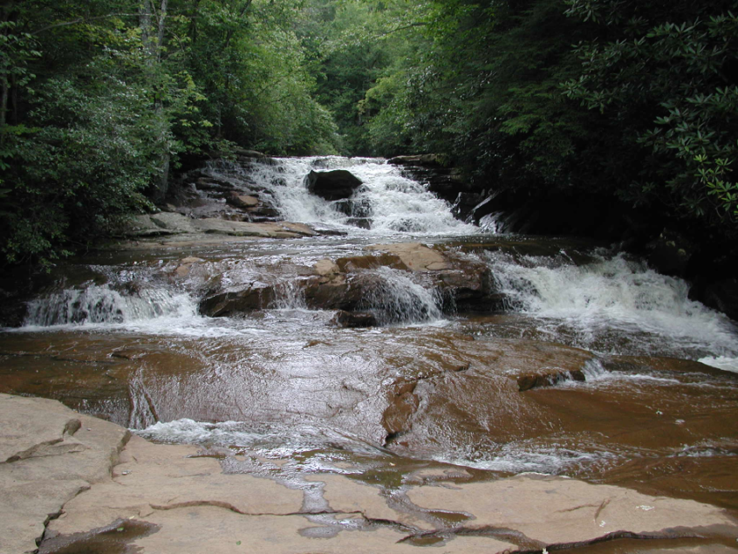
DISSOLVED OXYGEN
Dissolved oxygen is a product of photosynthesis and diffusion.
The warmer the water, the less oxygen it can hold.

Slide 14
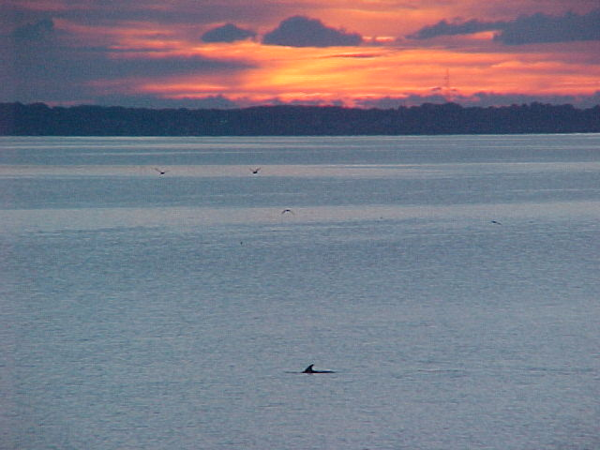
DISSOLVED OXYGEN
Most organisms need at least 5 or 6 ppm of oxygen in order to survive.
Even cold water rarely contains more than 15 ppm. Summer is often a time of oxygen stress for aquatic organisms.

Slide 15
CONDUCTIVITY
Conductivity measures the water’s ability to conduct an electrical current.
Pure water is a poor conductor.

Slide 16
CONDUCTIVITY
The addition of dissolved solids, especially salts, increases the conductivity of water.
Electrical current is measured using a conductivity meter.

Slide 17
HARDNESS
Hardness refers to the concentration of calcium and magnesium in water.
Hard water has high concentrations of these elements. Soft water has low concentrations.
Water hardness often originates from limestone.

Slide 18
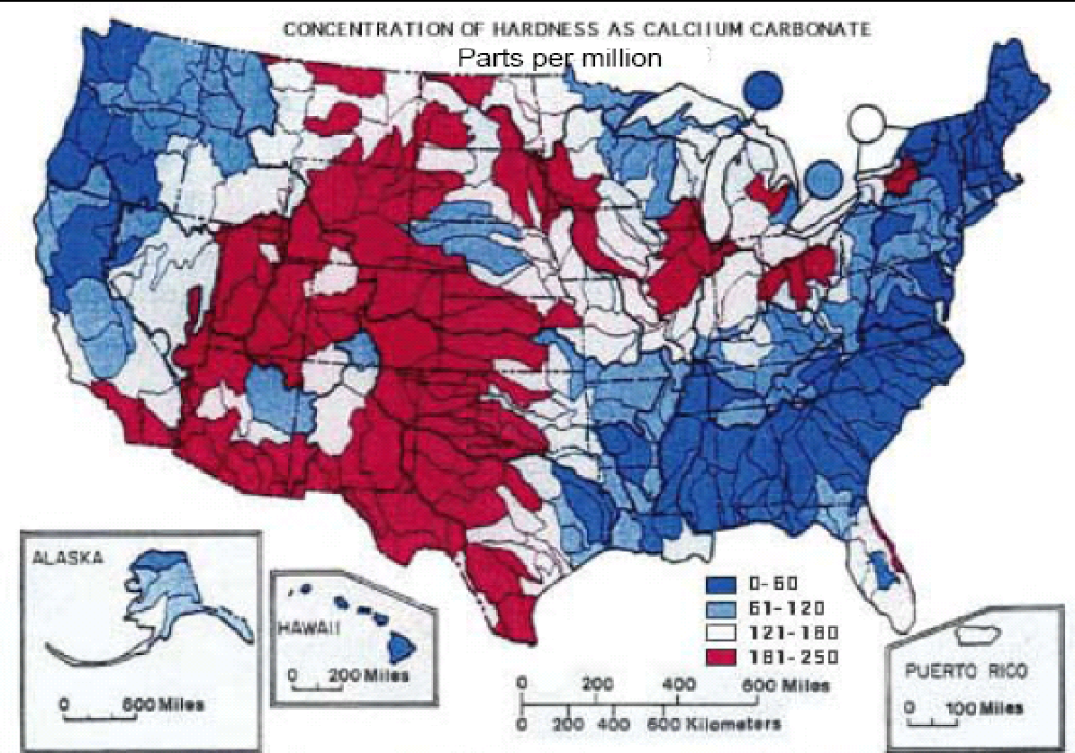
HARDNESS
Area of the U.S. with limestone bedrock have hard water.
Hard Water

Slide 19
NITRATE
Nitrate is a primary plant nutrient.
Nitrate is water soluble and moves easily from surface to groundwater.
Excess nitrate causes algal blooms that reduce water quality.

Slide 20
Under normal conditions, the nitrogen cycle keeps the amount of available nitrogen in balance with the demands. However, excessive use of fertilizers and nutrient rich sewage release have created a surplus of nitrate. The result is eutrophication from excess algae and bacteria with reduced dissolved oxygen.

Slide 21
PESTICIDES
These chemicals are very complex.
Effects on aquatic organisms – Moderately to highly toxic to mammals, mollusks, aquatic insects, amphibians and fish.

Slide 22
pH
pH is the measure of the hydrogen ion (H+) concentration.
The pH scale is zero to 14. Seven is neutral, below seven is acidic, and above seven is basic (or alkaline).
Most aquatic organisms exist within a pH range of 5.5 to 9.5.

Slide 23
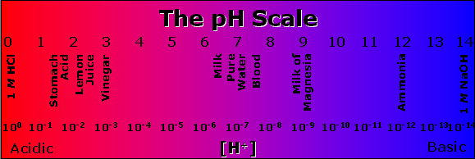
Carbon dioxide reacts with water to form a weak acid called carbonic acid.
pH tolerance for most aquatic life

Slide 24
Phosphate
Phosphate’s concentrations in clean water is generally low; however, phosphorus is used extensively in fertilizer and other chemicals.

Slide 25
Phosphate
The primary sources of phosphates to surface water are detergents, fertilizers, and natural mineral deposits.

Slide 26
Phosphate
High levels of phosphate can over stimulate the growth of aquatic plants and algae.
This in turn, will cause high DO consumption and death to fish and many aquatic organisms.

Slide 27
Sediment
Erosion causes loose soil to enter the waterways

Slide 28
Sediment
Suspended sediment blocks sunlight to plants and reduces dissolved oxygen.
As sediments settle, they can smother bottom (benthic)
organisms.

Slide 29
TEMPERATURE
Temperature is measured in Fahrenheit and Celsius degrees.
Temperature can be measured using field thermometers but digital probes are much more accurate.
Most aquatic organisms live within a temperature range of +32º F (+0º C) to 90º F (32º C).

Slide 30
Rapid temperature change and temperature extremes can stress aquatic organisms.
Temperature affects the oxygen-carrying capacity of water.
14 Dissolved Oxygen (ppm)
12
10
8
6
4
____________________________________
Winter Summer
As the water warms, the amount of dissolved oxygen decreases.

Slide 31
TOTAL DISSOLVED SOLIDS (TDS)
TDS is the measure of the material dissolved in water.
This measure is related to hardness, salinity and conductivity.
Hard water has more TDS than soft water.

Slide 32
TOTAL SUSPENDED SOLIDS (TSS)
TSS is the measure of the sediment suspended in the water.
TSS is related to turbidity.
Water with high TSS usually has high Total Dissolved Solids (TDS) as well.

Slide 33
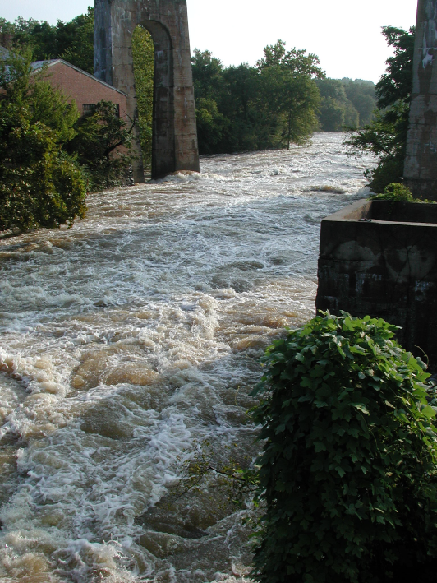
TURBIDITY
Turbidity refers to water clarity.
Sediments suspended in the water increase turbidity.

Slide 34
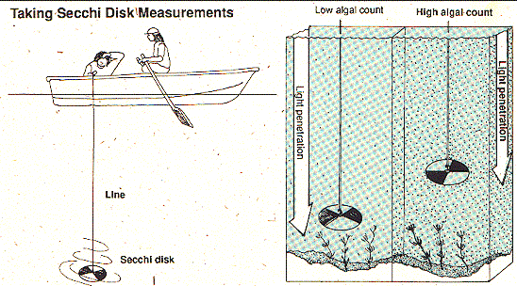
A secchi disk is one type of instrument used to measure turbidity.

Slide 35
TOXIC CHEMICALS
Toxic chemicals usually come from industry and energy production.
The effects are often not known until years after they have entered the environment.

Slide 36
Toxic chemicals include heavy metals (lead, mercury), organic compounds (DDT, PCB), inorganic substances (arsenic) and others.

